Slide 1
Mining People’s Trips from Large Scale Geo-tagged Photos
Presented by :
Mridul Sachan (16IT09F)

Slide 2
Contents:
Introduction
Identified Research Gaps
Methodology
Innovation
Feasibility Study
Conclusion

Slide 3
Introduction
Photo Sharing is the most popular Web services.
Photo sharing sites provide functions to add tags and geo-tags to photos to make photo organization easy.
We focus on geo-tagged photos and propose a method to detect people’s frequent trip patterns i.e. typical sequences of visited cities and durations of stay as well as descriptive tags that characterize the trip patterns.
Since these geo-tagged photos are associated with locations, we can trace people’s trips from them.

Slide 4
identified research gaps
Paper | Author | Work
PhotoTOC: Automatic Clustering for Browsing Personal Photographs | John C. Platt, Mary Czerwinski, Brent A. Field Feb 2002 | Proposed a method to automatically classify people’s photo collection into events using captured time stamps.
Automated Event Clustering and Quality Screening of Consumer Pictures for Digital Albuming | Alexander C. Loui September, 2003 | Proposed a method for photo classification using a K-means algorithm based on captured times.
Automatic organization for digital photographs with geographic coordinates | Mor Naaman, Yee Jiun Song, Andreas Paepcke, Hector Garcia-Molina in 2004 | Focused on the geographical location of photos for the task of photo organization.
Methods for Extracting Place Semantics from Flickr Tags | Rattenbury, T. and Naaman, In 2008 | Mined Flickr’s geo-tagged photos to extract semantics of locations.

Slide 5
Methodology
Photo Collection Segmentation
City Name Detection
Photo Trip Classification
Photo Trip Pattern Mining
Trip Description Detection

Slide 6
1. Photo collection segmentation
Common idea of conventional approaches for event detection from a photo is to use gaps of captured times.
Additionally, tags assigned to each photo well describe the trip, such as landmarks and people captured.
Moreover, users tend to assign the same tags on groups of consecutive photos, which should enforce the photo collection segmentation algorithm.
Therefore, we use captured time gaps, location gaps, and tags on photo collection segmentation.

Slide 7
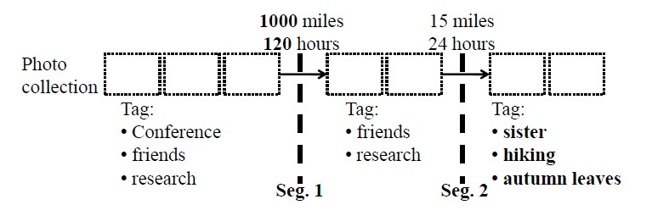
Example of photo collection segmentation

Slide 8
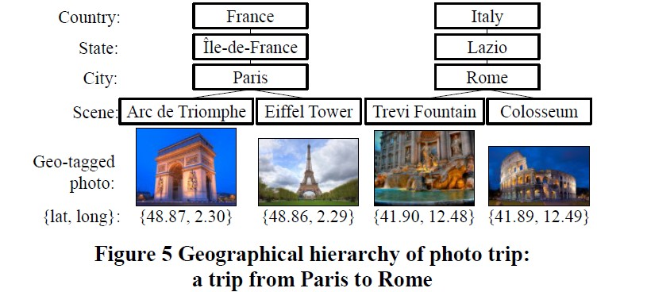
2. City name detection

Slide 9
City name detection…
Geo tagged photos have a geographical hierarchy, i.e., city, state, and country, which enables us to interpret their locations by different levels of view.
Therefore, we focus on the city level of locations for photo trip pattern mining.
We will use public Web APIs to convert a latitude/longitude to city/state/country names.
After associating city names in a photo trip, we detect visit durations on cities. We regard the captured time of the first photo taken in a City as the time a user entered the City.

Slide 10
3. Photo trip classification
Trip Themes
We have defined six categories as the trip themes and proposed an algorithm to classify trips into one of them.
Classifier
For photo trip classification, we use linear Support Vector Machines (SVMs).
Features
We represent a photo trip by a feature vector by focusing on their spatial and temporal attributes.

Slide 11
3.1 Trip Themes :
After surveying several Websites of travel agencies, travel forums and blogs about travel experiences, we found 6 chief objectives on trips:
Landmark : visiting famous landmarks, e.g. : famous sightseeing spots and world heritages, such as Taj Mahal.
Nature : visiting places famous for rich nature, such as Surathkal Beach.
Gourmet : visiting places to taste delicious foods, such as Dominos Pizza in Mangalore.
Event : visiting places to attend an event, such as Run Delhi Run or a wedding ceremony.
Business : visiting places with business oriented aims.
Local : including small and daily trips to nearby areas, such as getting together with friends at NITK beach.

Slide 12
3.2 Classifier
For photo trip classification, we use linear Support Vector Machines (SVMs).
To train SVMs, we manually labelled randomly selected photo trips by their themes.
Since we classify trips into six categories, we train a separate SVM using Machine learning technique (Support Vector Machine Learning for Interdependent and Structured Output Spaces ) for each of the trip themes.
To perform photo trip classification, we run each of the 6 classifiers on a photo trip and choose the category with the highest score.

Slide 13
3.3 Features
We represent a photo trip by a feature vector by focusing on their spatial and temporal attributes, photo capturing behaviors in the photo trips, and textual features of photos as listed below.
Spatial Feature: feature vector of visited cities in the photo trip.
Temporal Feature: month, day of week, time slot that the user spent for his/her photo trip, and the trip duration.
Behavioral Feature: average, median and standard deviation of photo capturing interval and user’s movement speed.
Textual feature : feature vector generated based on tags and titles associated with photos of the trip.

Slide 14
4. Photo TRIP PATTERN MINING
We detect frequent photo trip patterns for each trip theme.
Since City sequences annotated with visit durations in a photo trip can be regarded as TAS( Temporally Annotated Sequences).
We apply the TAS( Temporally Annotated Sequences) mining algorithm proposed by the two Italian researchers - Fosca Giannotti and Mirco Nanni.
TAS is an extension of sequential patterns that enrich sequences with information about the typical visit durations between their elements.

Slide 15
5. Trip Description detection
As the final step, we extract typical descriptions of each photo trip pattern using tags assigned to photos.
T.D.D is based on the TF/IDF technique, assuming that tags that primarily occur in photos captured in a trip pattern and do not frequently occur in others are more representative to the pattern.
We aim to detect trip descriptions, which represent characteristics of a trip pattern.

Slide 16
Innovation
Scene detection from geo-tagged photos.
We classified a photo trip into a theme, but it is natural to think that people travel with several aims, such as to visit Gateway of India after finishing a business meeting.
We can detect additional contexts of trips from photos, which are not described by tags, from physical contexts (such as weather and temperature) to situational contexts (such as how many people are there and who is the main character in the trips).

Slide 17
Feasibility Study
Here, we have focused on geo-tagged photos and proposed a method to detect people’s frequent trips.
Data Set : We will be using the dataset of Flickr geo-tagged images for mining the frequent trip patterns.
For photo segmentation, we will use the Algorithm proposed by Crandall, D., Backstrom, L., Huttenlocher, D. and Kleinberg, J. In their research paper with Title Mapping the World’s Photos in ACM 978-1-60558-487-4/09/04.
For City Name Detection, we will use the Flickr’s public Web APIs.
For photo trip classification, we use Support Vector Machines concept of Machine Learning given by Tsochantaridis, I., Hofmann, T., Joachims, T. and Altun, Y. in their research paper with Title - Support Vector Machine Learning for Interdependent and Structured Output Spaces.
For feature vector selection, we will use an Algorithm given by Porter, M.F. with title - An Algorithm for Suffix Stripping.

Slide 18
Feasibility Study (contd…)
TAS Algorithm (Temporally annotated sequential) is applied for mining the Photo Trip Patterns proposed by Giannotti, F., Nanni, M. and Pedreschi, D. in the year 2007 with title - Efficient Mining of Temporally Annotated Sequences.
For Trip Description Detection, we will use the techniques proposed by Qiang Hao†*, Rui Cai‡ , Xin-Jing Wang , Jiang-Ming Yang , Yanwei Pang , and Lei Zhang in their research paper with title - Generating Location Overviews with Images and Tags by Mining User-Generated Travelogues.

Slide 19
Conclusion
We have defined the idea of a photo trip and proposed frequent photo trip pattern mining algorithms that can detect novel trip knowledge from geo-tagged photo collections on the Web.
We first segment photo collections into photo trips and classify them based on their trip themes.
Then we detect frequent photo trip patterns as sequences of frequently visited cities and their typical visit durations.
Furthermore, we mine tags considering their geographical coverage to add descriptions of photo trip patterns.

Slide 20


